Slide 1

Watch Video
Call : +91 9629754500
Email: contact@codeshoppy.com

Slide 2
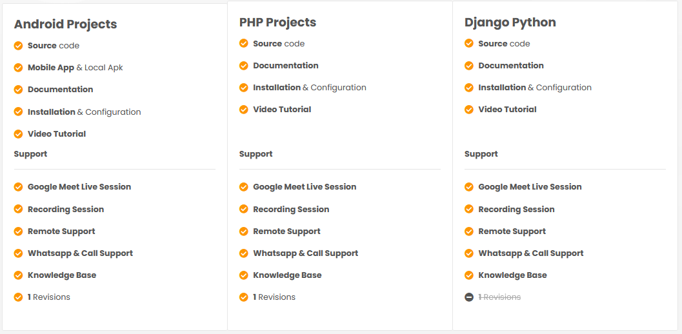

Slide 3
Student-Teacher Booking Appointment

Slide 4
AIM OF THE PROJECT
In this application booking appointment systems are prevalent currently either online or using traditional queuing systems. Several businesses like book appointment use different Web-based appointment systems for their patients which make appointments process more efficient, thereby minimizing patient’s waiting time and maximizing the total number of patients served.
Student-teacher booking appointment app is that it allows students to customize their booking process. This includes the ability to select the timeframe, the location, and even the type of appointment they'd like to book. This way, students can easily find the best appointment that fits their needs and schedule.
This study presents a web based appointment booking system through web or mobile devices that assists both students and lecturers to be acquainted with the time of appointment wherever they are.
The system allows students and lecturers to simply gain access to the system by connecting to the Internet. It also enables students to drop any message which consists of the purpose and time of the appointment
Student-teacher booking appointment apps are incredibly helpful for students and teachers alike. They make the entire booking process simple and efficient, and with customizable options, students can make sure that their appointments fit their needs.

Slide 5
OBJECTIVE OF THIS PROJECT
The Student-Teacher Booking Appointment is compatible mainly with concept of Booking Appointment . The main objectives of our proposed system are as follows:
The Student-Teacher Booking Appointment app is designed so that both students and teachers have an easy and efficient way to book appointments with each other.
Once the appointment time arrives, you can easily attend the meeting with your teacher. Your teacher will also be able to access all the details regarding the appointment.
For teachers, the app makes it easy to manage and monitor their students’ appointments. They can set their availability, create and manage appointments, send reminders, and review student progress reports.

Slide 6
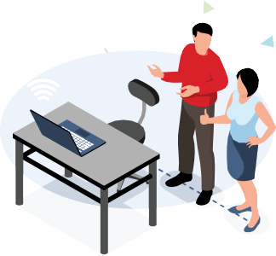
SOFTWARE AND HARDWARE REQUIREMENTS
HARDWARE REQUIREMENTS:
Processor : Intel 3
Motherboard : Intel mother board – VTx Enabled
Ram : 4 gb
Hard disk drive : 500 gb
SOFTWARE REQUIREMENTS:
Front End: HTML5, CSS3, Bootstrap
Back End: PHP 7.4, MYSQL
Control End: Angular Java Script
Android TOOLS:
IDE: Android Studio
Android Emulator
xampp-win64-7.4
PHP Tools:
xampp-win64-7.4

Slide 7
EXISTING SYSTEM
The existing system is the manual system. All the records are maintained in the project. Need to be converted into automated system.
To understand different symbols which are used in books and travel guides is a tedious job. User requirement are not satisfied through these books and Manuals
In People should push the vehicles or get help to reach nearest gas station. In the above method time and manual work is done by owners of the vehicle.
For some aged people or medically ill people it will get even hard. To get fuel to fill generators people need to go to a petrol station.

Slide 8
DISADVANTAGES OF EXISTING SYSTEM
It isn't compelling and which has a few hindrances which as pursues Less powerful and tedious.
Student-teacher booking appointment system .One of the main issues is that a centralized system can be difficult to maintain, as it requires a large amount of data to be collected and inputted into the system to ensure that it is accurate.
Student-teacher booking appointment system is that it can be difficult for students to access their bookings remotely.
Loss of Classroom Interaction- By relying too heavily on student-teacher booking appointment apps, students may lose out on the opportunity to engage with their teachers in a classroom setting.
. Overbooking- Without proper tracking, it can be easy for students and teachers to overbook their appointments, leading to long wait times and frustration for both parties.
Technical Difficulties- While student-teacher booking appointment apps are great for convenience and time management, they can also be subject to technical difficulties that can lead to disruptions in the process.

Slide 9
PROPOSED SYSTEM
They are very popular because a new application can be released without needing to install a new version on the client computers. Web application of an online appointment booking system within an academic institution is an area of fast growth because it is a more effective way of handling administrative issues.
The server will collect the data and store them only a database. This data will be analyzed and displayed on two different dashboards that can be accessed by the workforce and clients.
Online appointment systems are used extensively in hotels, hospitals, etc. for scheduling appointments and to keep track of patients’ records.
This appointment scheduling system for students should be able to aid the task of booking an appointment with lecturers

Slide 10
ADVANTAGES OF PROPOSED SYSTEM
Increased Communication- Student-teacher booking appointment apps help to foster increased communication between students and teachers. This can be especially beneficial to those students who may not feel comfortable speaking up in a classroom setting.
Time Management- By utilizing student-teacher booking appointment apps, students and teachers are able to better manage their schedules and prioritize their tasks. This can lead to better time management when it comes to completing assignments and preparing for test .
Student-teacher booking appointment system can provide more flexibility for both teachers and students.
Convenience- With student-teacher booking appointment apps, both students and teachers can easily manage their schedules and book meetings with one another without having to go through the hassle of finding a time that works for both parties.

Slide 11
MODULE LIST
STUDENT
Register
Login
Search Teacher
Book Appointment
Send Message
TEACHER
Login
Schedule Appointment
Approve/cancel Appointment
View Messages
View All Appointment
Logout

Slide 12
MODULE LIST
ADMIN
Admin Login
Add Teacher
Update/Delete Teacher
Approve Registration Student

Slide 13
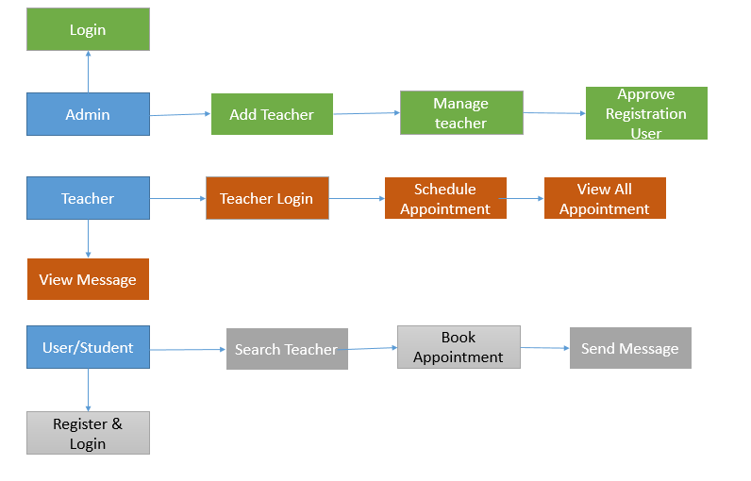
DIAGRAMS
ARCHITECTURE DIAGRAMS

Slide 14
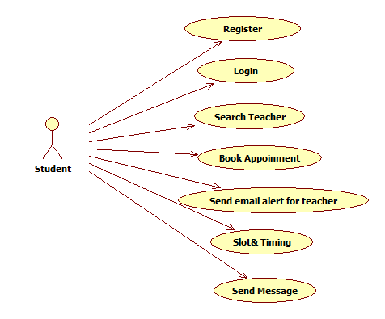
USECASE DIAGRAMS

Slide 15
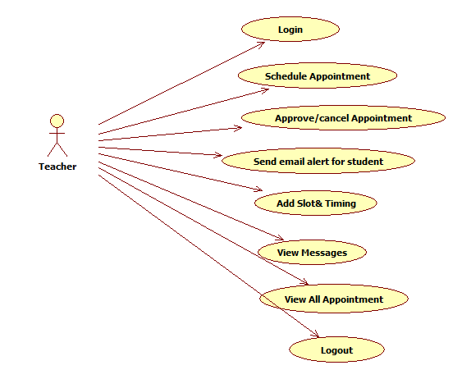
USECASE DIAGRAMS

Slide 16
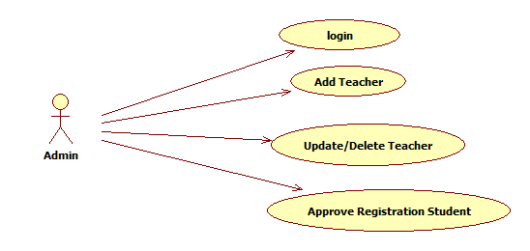
USECASE DIAGRAMS

Slide 17
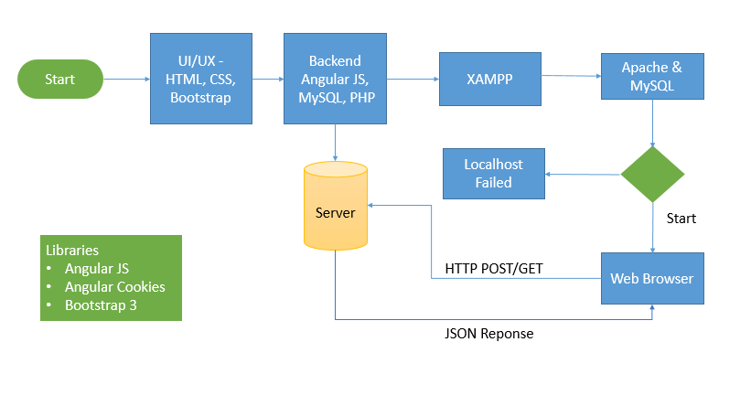
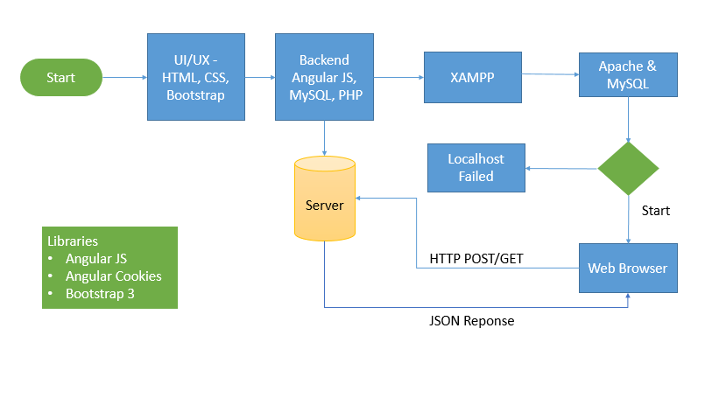
WORKFLOW DIAGRAM FOR WEB APPLICATION

Slide 18
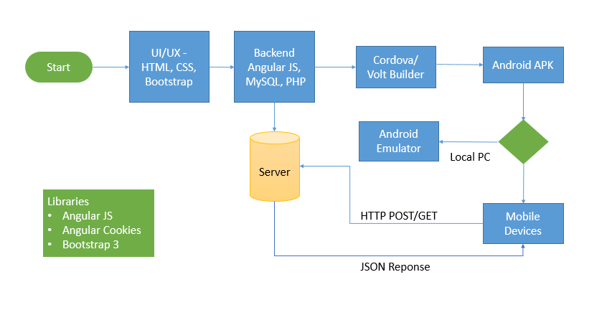
WORKFLOW DIAGRAM FOR ANDROID APPLICATION

Slide 19
SCREENSHOTS

Slide 20
CONCLUSION
The student-teacher web-based booking appointment application developed for academic institutions provided a login menu and a registration form for new user this comprises of an interface that is user-friendly to capture password, username and registration codes, for the student to log in unto the account.
The student-teacher booking appointment system has revolutionized the way teachers and students interact and communicate. This system has provided a convenient way for students to book appointments with their teachers and for teachers to manage their schedules and appointments.
the student-teacher booking appointment system has been a great success. This system has enabled both teachers and students to be more organized, efficient, and productive. It has also allowed for better communication between teachers and students and has enabled teachers to better monitor student progress.

Slide 21
FUTURE ENHANCEMENT
Security Measures - Security is paramount when it comes to any digital system, and a student-teacher booking appointment system is no different. Data breaches and other forms of cybercrime can have a devastating impact on any organization, and it's essential to make sure that the student-teacher booking system is as secure as possible.
Automated Confirmations - One of the biggest challenges in any student-teacher booking appointment system is the manual process of sending out confirmations. Doing this manually can be time-consuming and inefficient, and it can lead to mistakes being made. To remedy this, automated confirmations could be implemented.
Integration with Calendars - Integrating the student-teacher booking system with calendar applications such as Google Calendar or Microsoft Outlook would be a great way to make the process even more efficient.
User-Friendly Interface - Having a user-friendly interface is key to any digital system, and the student-teacher booking system is no exception. Ensuring that the user interface is intuitive and easy to navigate can help to streamline the process and reduce the risk of user error.

Slide 22
REFERNECES
Kulkarni Amruta M. & Taware Sachin S.―Embedded Security System Using RFID & GSM Module‖ (International Journal of Computer Technology & Electronic Engg.) Volume 2 (Issue 1), Page No. 164-168.
Behera Susanta K. & Ali Farida A. ―Automobile Fuel Pump Control System Using Embedded System‖ (International Journal Of Computer Technology & Electronic Engg.) Volume 3 (Issue 2), Page No. 41-47. April 2013.
Kapse Sagar Sudhakar, Abhale Amol Anil, Kudake chetan Ashok,Shirsath Shravan Bhaskar. ―Automatic Street Light Control System‖ (International Journal of Emerging Technology and Advanced Engineering) Volume 3, Issue 5, May 2013.

